Slide 1
London Flagships briefing
Monday 7th October
1pm to 3pm, City Hall

Slide 2
AGENDA
13.00 Welcome + Introduction to The School Food Plan
Myles Bremner, Director for The School Food Plan
13.15 Vision for the London Flagships
Rosie Boycott, Chair of The London Food Board
13.25 Cross-GLA support
Matthew Patten, Chief Executive of The Mayor’s Fund For London
13.30 Detail on the application process
Leah Schabas, Coordinator for The School Food Plan
13.40 Overview of GLA initiatives
Jonathan Pauling, Senior Policy Officer for GLA Food Programme
13.45 Q&A
15.00 End

Slide 3


The School food plan
http://www.schoolfoodplan.com/film/

Slide 4
London flagships vision
Improved health and attainment across the community through initiatives around food.

Slide 5
Some examples of activities, which might produce our four short-term outcomes:
Improve quality of food available
  Provide healthy free school meals to children beyond Year 2
  Ensure availability of fresh fruit and veg in stores in ‘food deserts’
  Restrict junk food outlets through planning regulations
  Run a ‘healthy checkouts’ initiative in supermarkets
  For those who facing hunger, run ‘food clubs’ with year round access to food
Increase understanding of how diet impacts health
  Run a borough-wide public health information campaign around food and diet
  Carry out nutrition education programmes in schools
Develop practical cooking skills
  Support schools in delivering cooking requirement in new national curriculum
  Set up after-school and holiday cooking clubs for families
Foster a love of good food
  Engage families in food growing through community gardens
  Organise local food festivals

Slide 6
Cross-GLA support for the FLagships

Slide 7
(provisional)
What does Flagships status entail?
  Funding of £1 million over two years
  Coordinated support from GLA team
  International best practice
  Public profile

Slide 8
(provisional)
What do we expect from Boroughs?
  Demonstrated track record
    Around food in schools
    Around food across the community
  Compelling proposal laying out how will
    Join up existing activities in a coordinated approach
    Address identified gaps and opportunities
    Launch creative innovative programs
    Utilise wider existing support available
    Work across party lines, and across private and public sectors
  Strong leadership buy-in and strategic alignment
  Evidence of matched funding
  Bring other partners on board
  Systems to ensure rigorous monitoring & evaluation

Slide 9
(provisional)
Other selection criteria:
  One inner borough, one outer borough
  Balance between demonstrating:
    Greatest need (e.g. food poverty, obesity rates)
    Best ability to implement (e.g. capacity, track record)

Slide 10
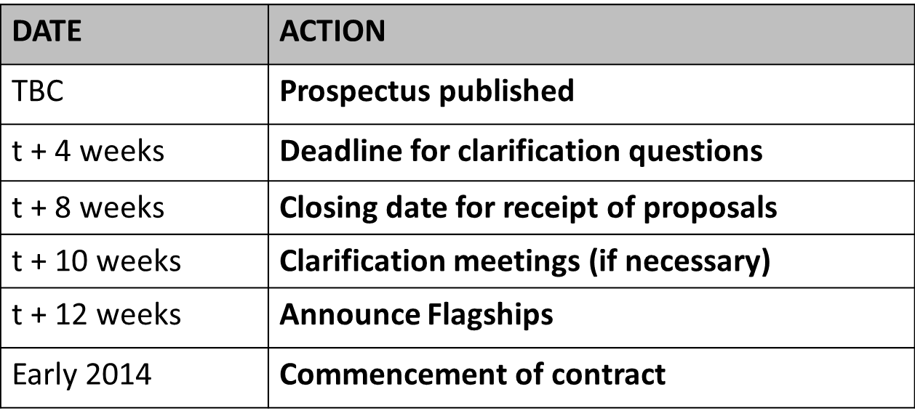
(provisional)
Timeline:

Slide 11
MAKING LINKS – THE GLA FOOD PROGRAMME
For further information contact Jonathan Pauling, Senior Policy Officer, Greater London

Slide 12
The food programme at the gla
Complimentary programmes

Slide 13
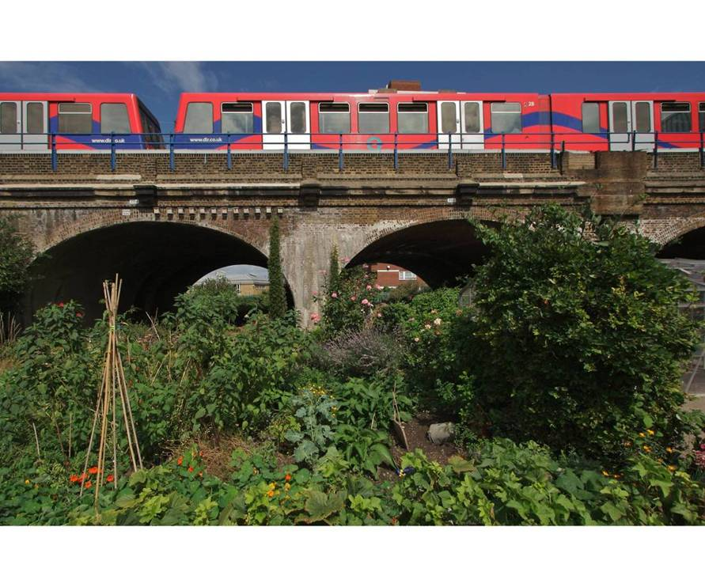
GLA Food Programme

Slide 14
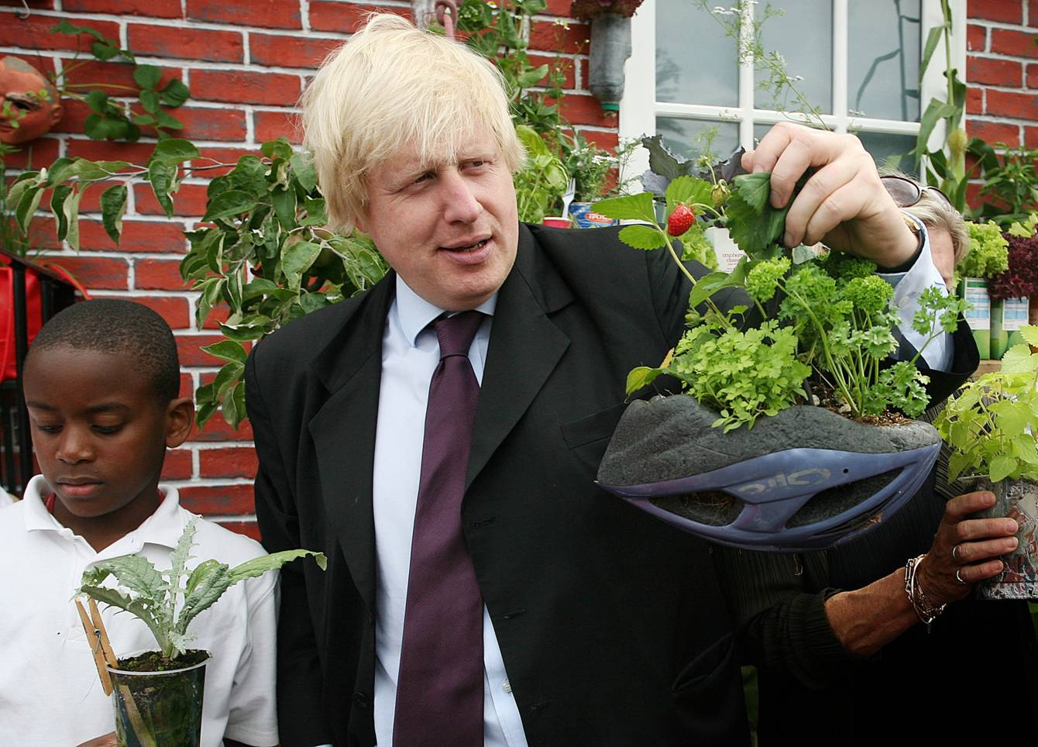

Slide 15
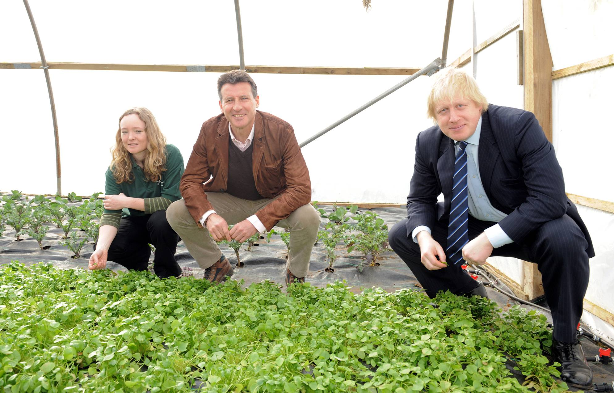
Capital Growth

Slide 16
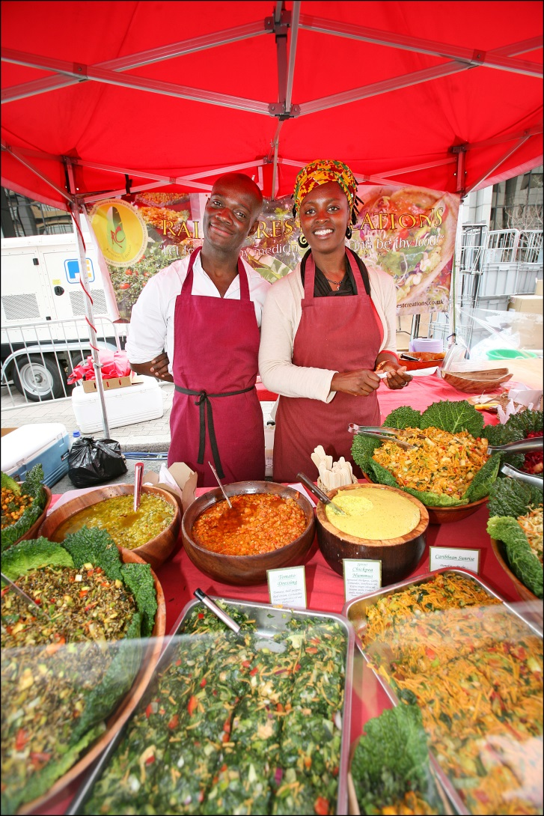
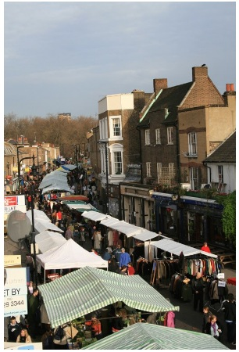
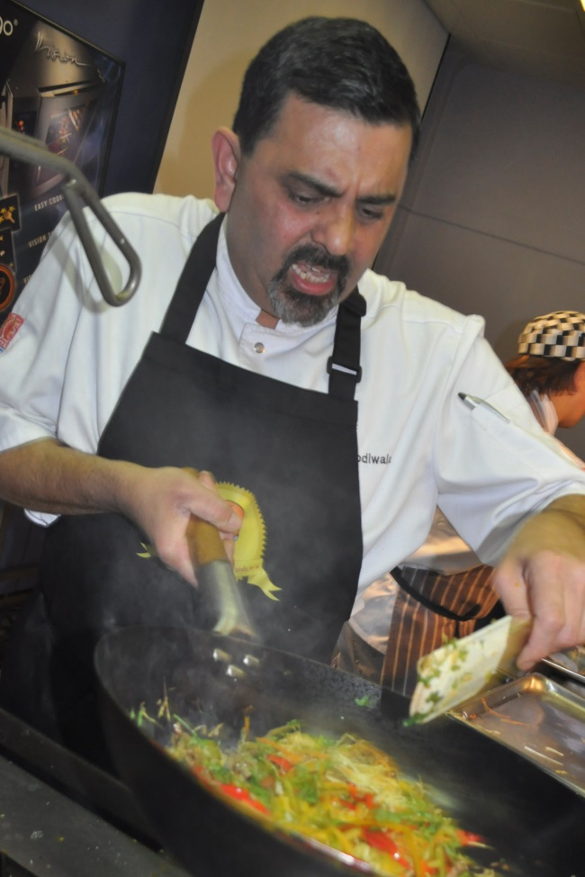
Food High Streets

Slide 17

Takeaways Toolkit

Slide 18
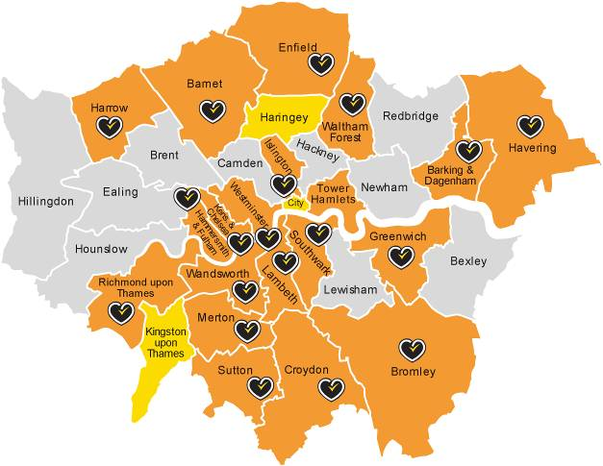


Healthier Catering Commitment

Slide 19

Good Food for London
Report 2013

Slide 20

Food Waste

Slide 21

Food Poverty

Slide 22

Find out More
Contact: Jonathan.Pauling@london.gov.uk
Phone: 020 7983 4595

Slide 23
Q & A
Our three key questions for YOU:
Are you up for this?
Who should we be talking to?
What do you need from us to get your decision-makers on board?

Slide 24
Thank you
Information from today’s briefing will be shared publicly at www.schoolfoodplan.com
If you have further questions, please contact Leah Schabas at leah.schabas@london.gov.uk

